Slide 1

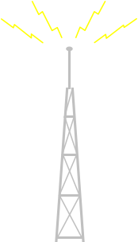
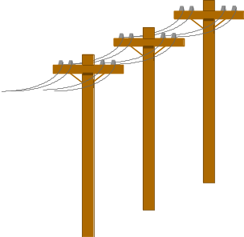



File Systems and Internet
Session 4

Slide 2
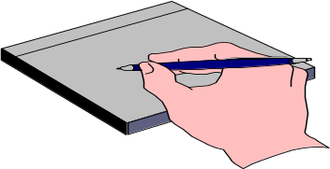
Session Objectives
Explain the concept of partitions and Volumes
Explain File Systems supported by Windows 2000
List Features of File Systems supported by Windows 2000

Slide 3
Session Objectives
Introduction to the Internet
An overview of Internet applications
The World-Wide Web
File Transfer Protocol
Email - The Internet as a postman
Understand the requirements for Internet Connection

Slide 4

Partitioning
Disk
Partitions
Disk partitioning -is one of the disk management techniques
It refers to the logical division of the hard disk
It divides the memory unit into isolated sections
Partitioning is particularly useful if more than one operating system is used in a system
Before a hard disk is formatted with FAT or NTFS file system (s), a portion should be marked on it to contain the file system

Slide 5
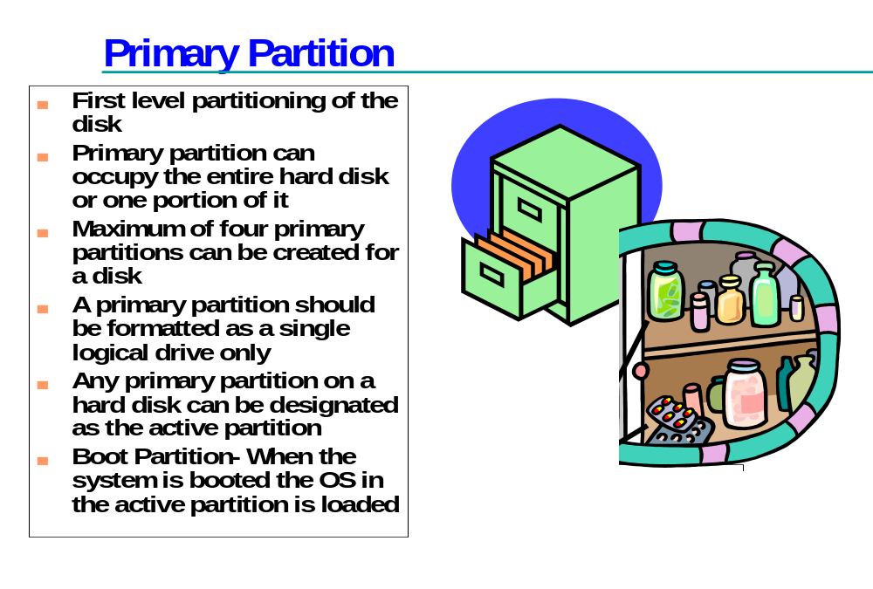

Slide 6
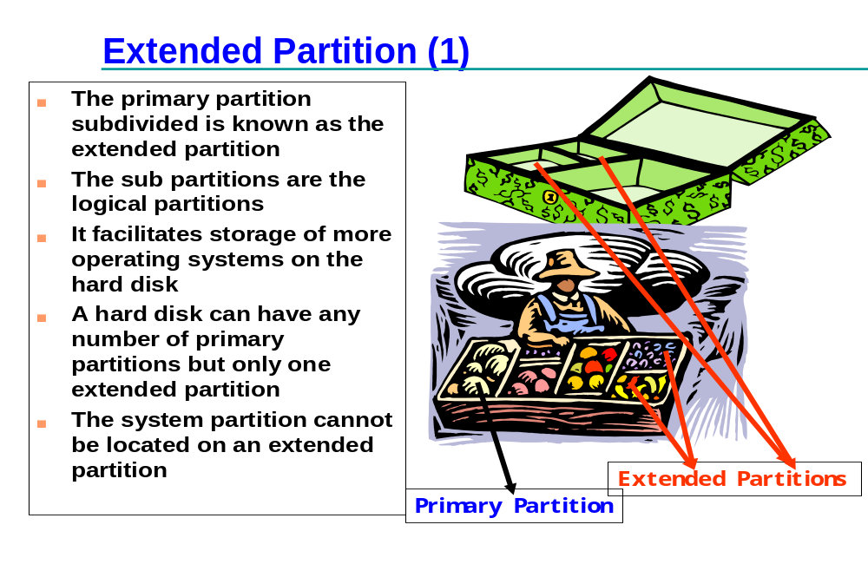

Slide 7
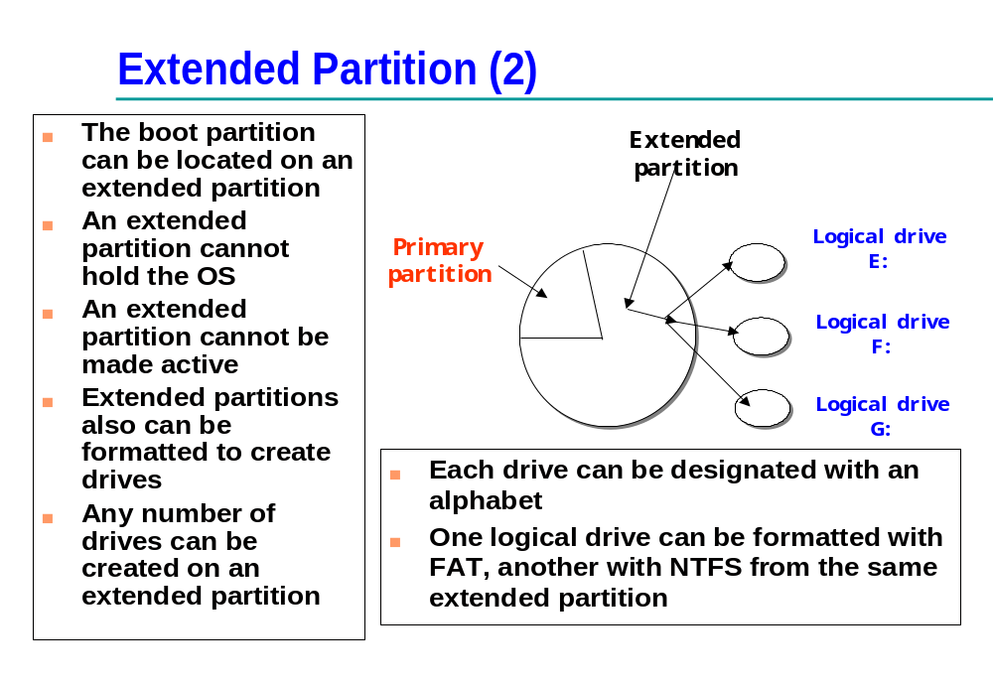

Slide 8
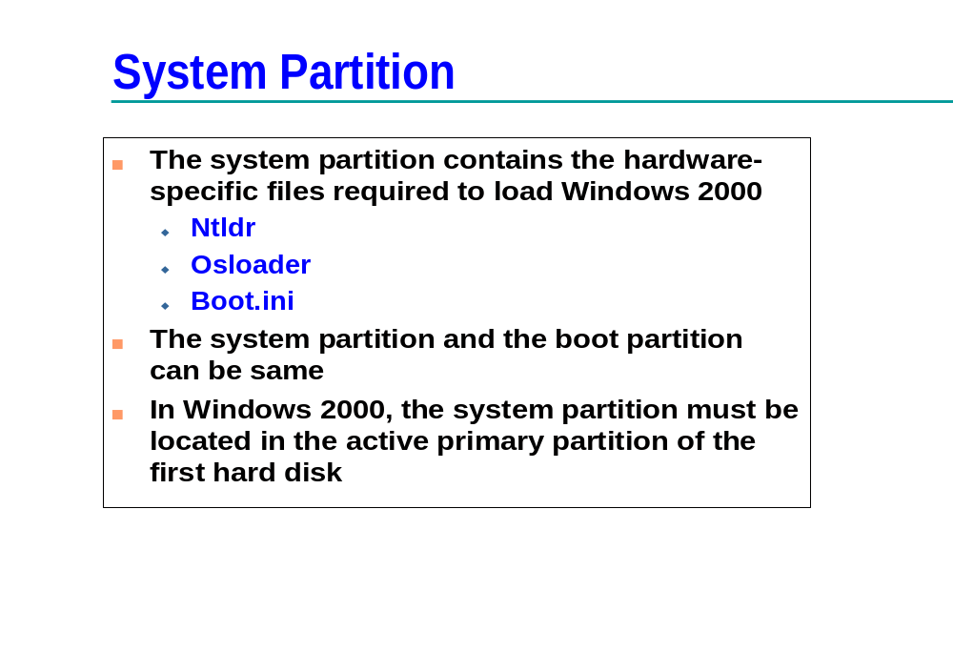

Slide 9
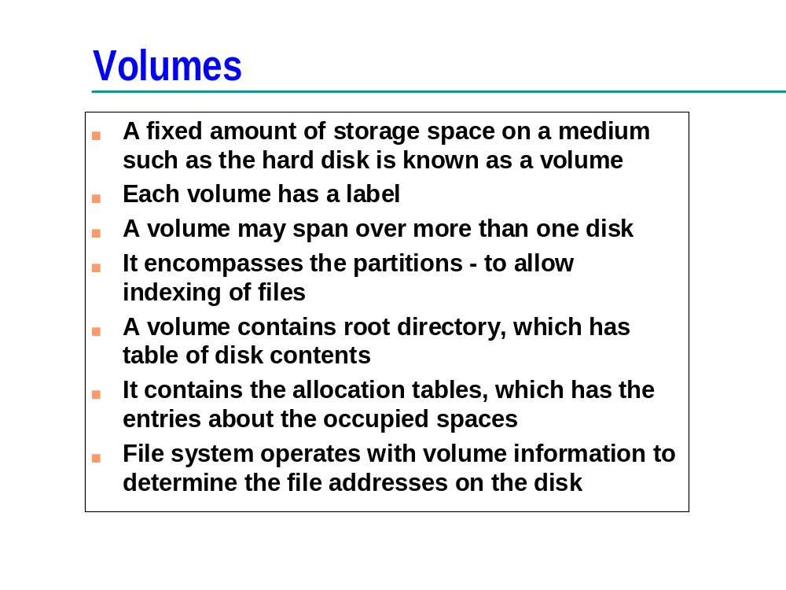

Slide 10
Volumes
Simple volume
Striped volume
Spanned volume
Mirrored volume

Slide 11
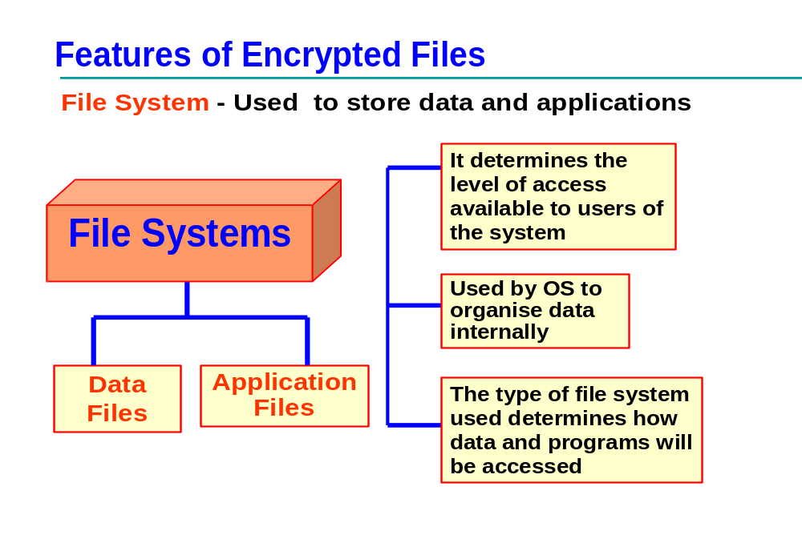

Slide 12
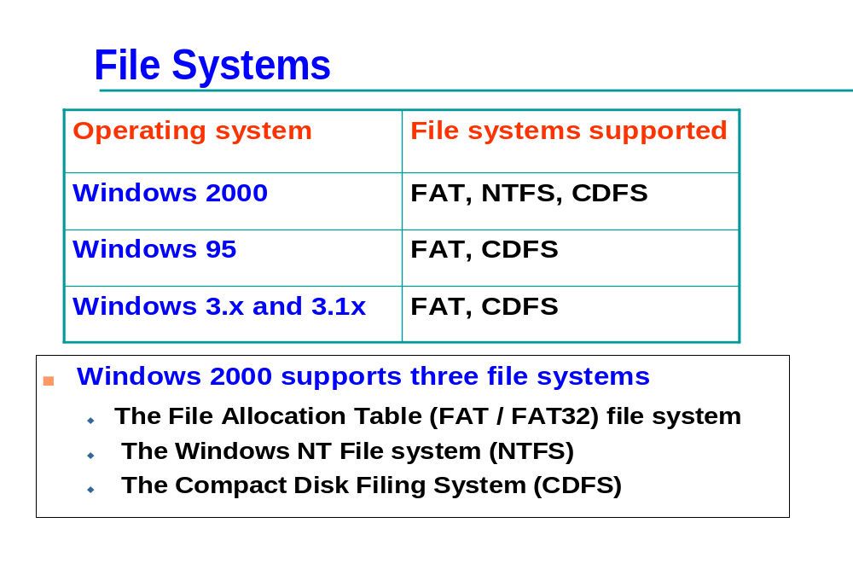

Slide 13
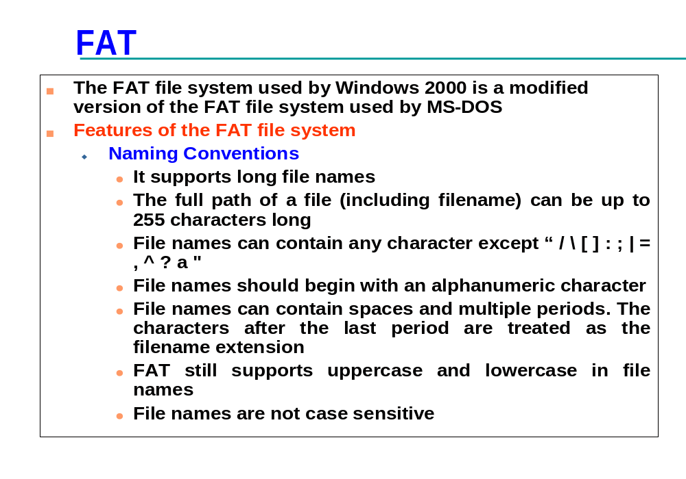

Slide 14
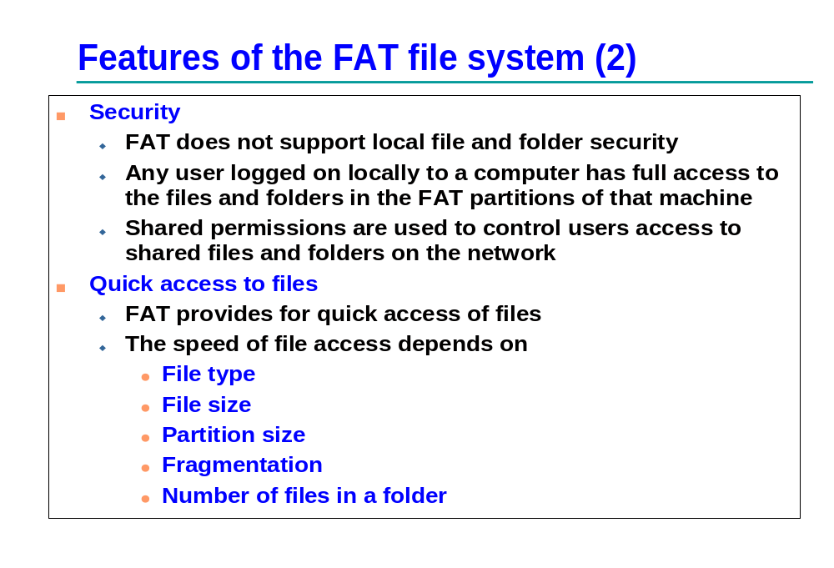

Slide 15
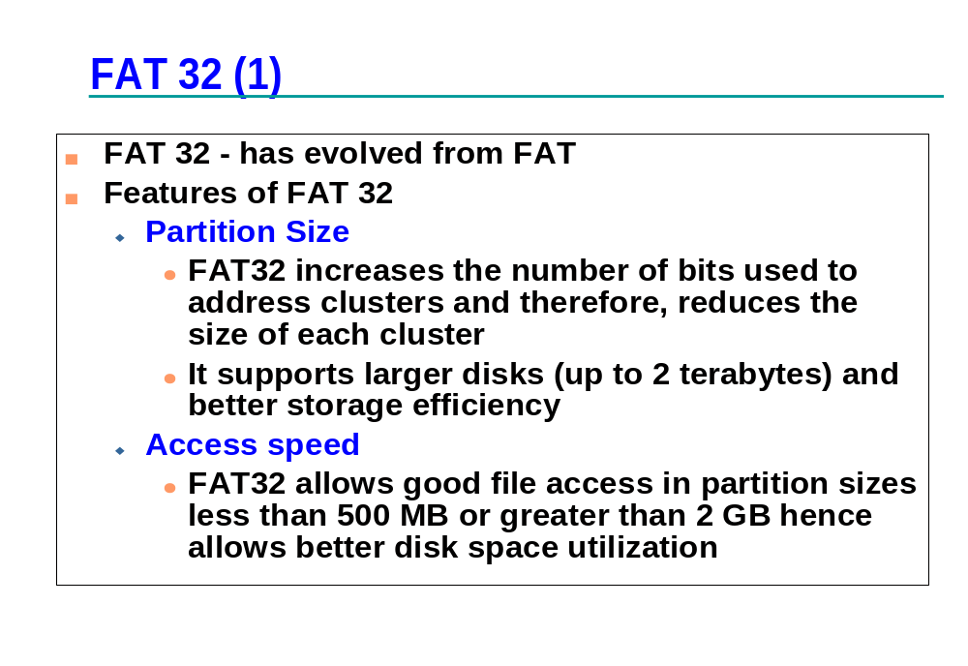

Slide 16
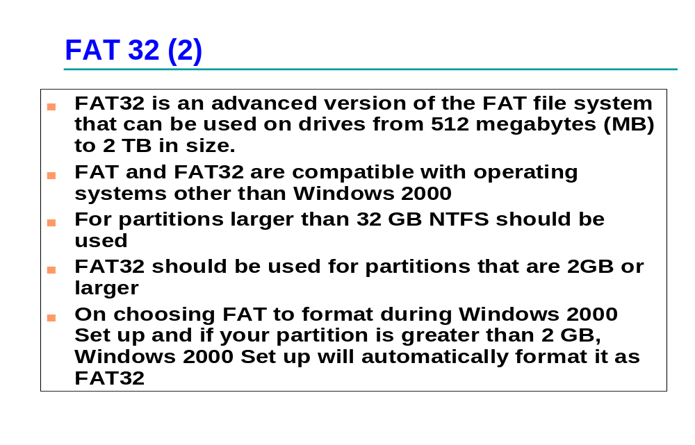

Slide 17
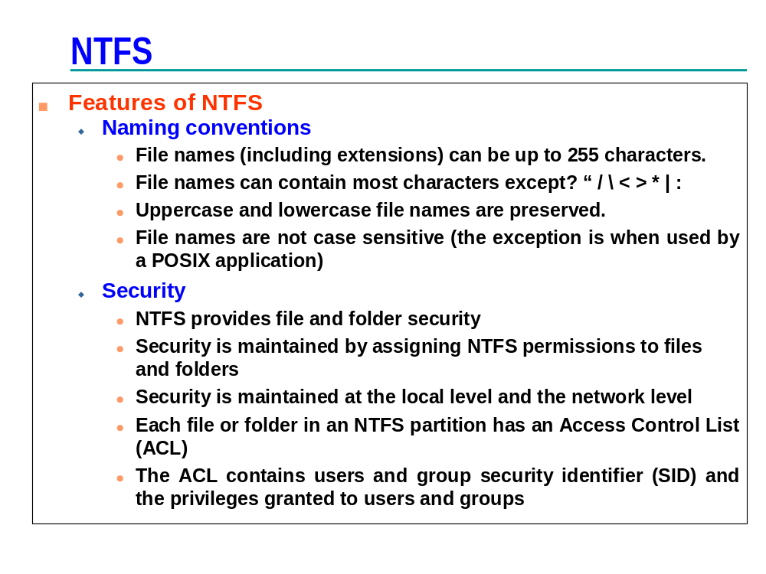

Slide 18
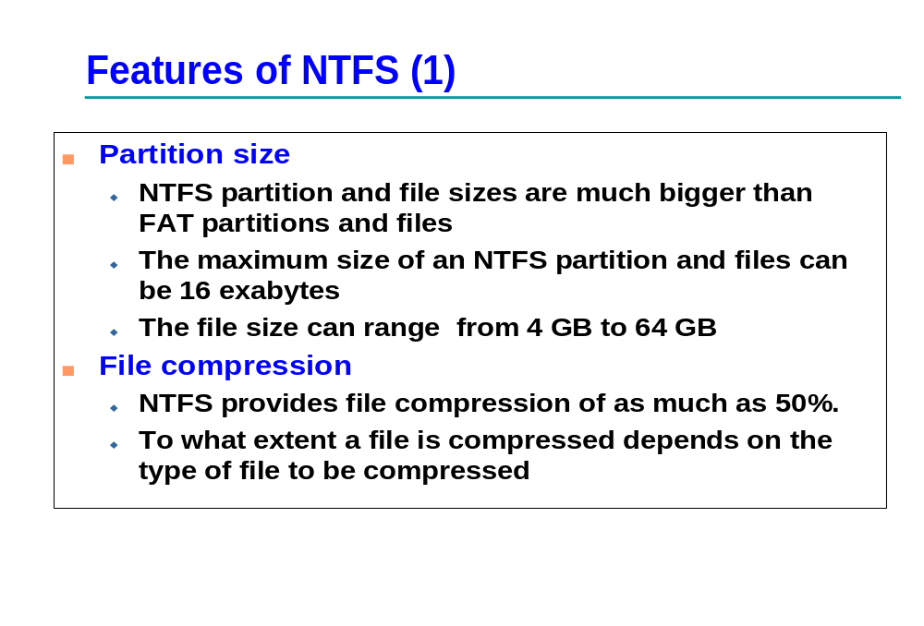

Slide 19
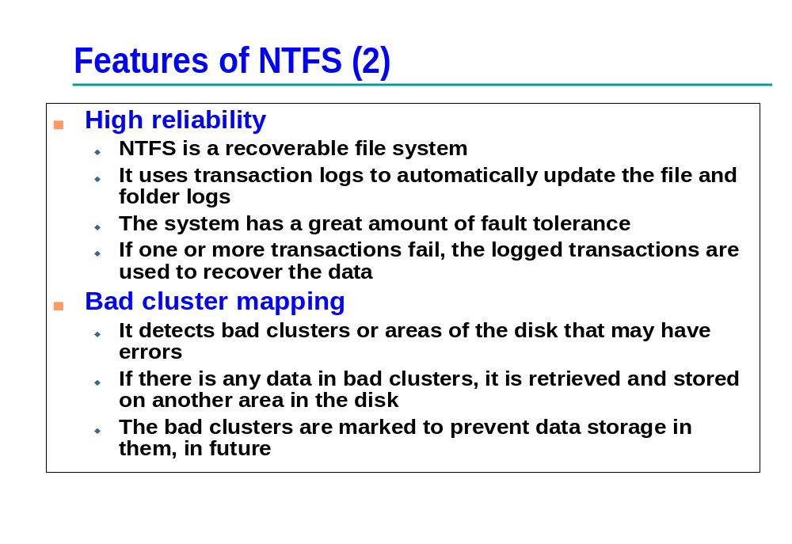

Slide 20
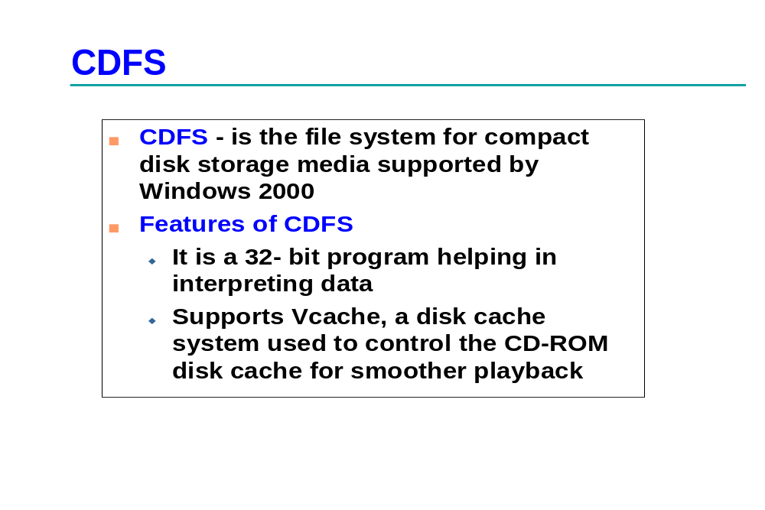

Slide 21
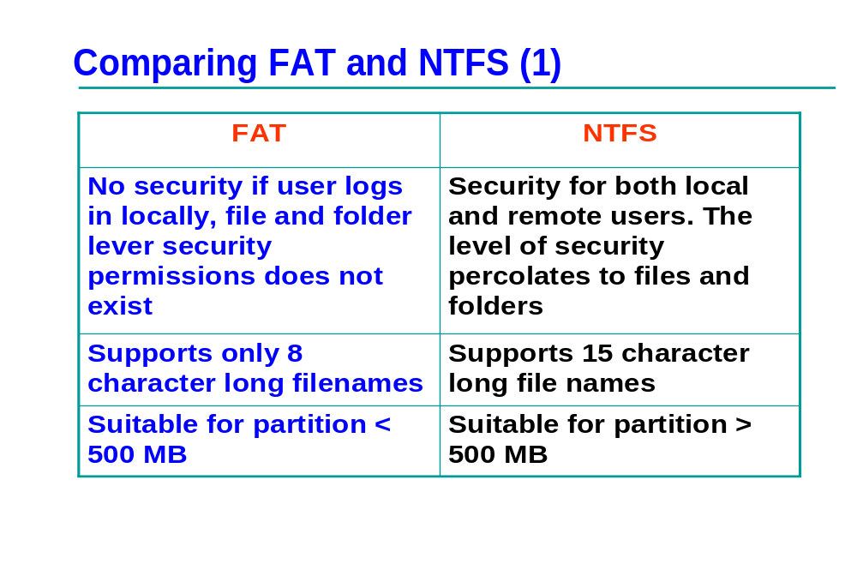

Slide 22
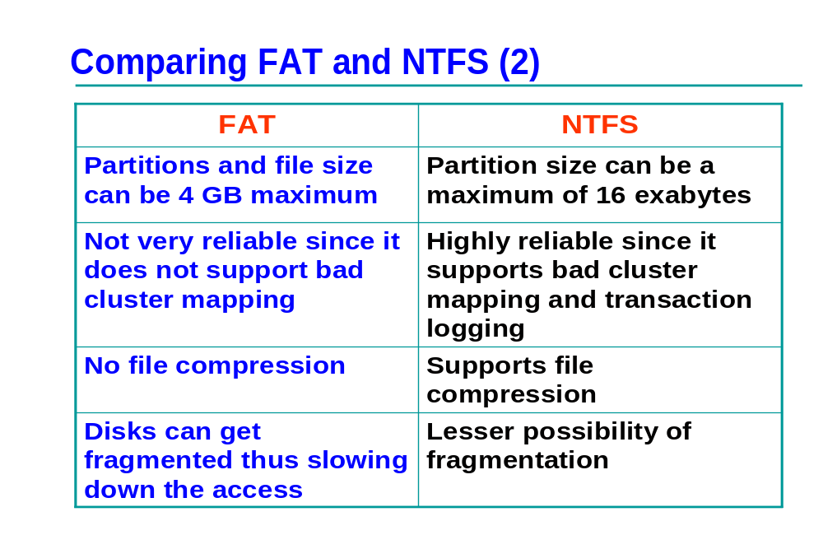

Slide 23
The Internet
Like the library, the Internet is also a:
  enjoyable
  varied and
  interesting
source of information which can be used by netizens

Slide 24

Uses Of Internet
1. On-line employment
2. Net Banking
3. On-line education system
4. Making friends and participating in a discussion
5. Send and receive electronic greetings from friends and relatives
6. Go through the catalog of a library

Slide 25
Uses Of Internet (contd...)
7. Visit an electronic zoo or museum
8. Find out most popular programming languages
9. Download interesting software
10. Publishing your portfolio over the
net
...

Slide 26






Internet Resources
WWW
FTP
Email

Slide 27


The World-Wide Web
User-friendly
Universal database of knowledge
Web Pages - made up of Hypertext

Slide 28
The WWW (contd...)
Some technical terms:
Hypertext
Link
HTTP
Browser
Address

Slide 29
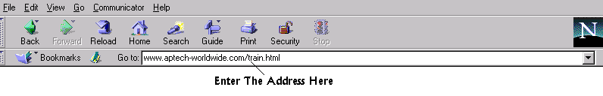
Web transaction
Steps in a web transaction:
Selection of Hyperlink
Connection to server address
Server services the request

Slide 30

File Transfer Protocol
Is a method of:
Transferring files
Sharing software

Slide 31
Advantages of FTP
Speed
Cost Effective
Choice

Slide 32




Email
Method to send messages from one computer to another
Made up of two parts :
  The Address
  The Message

Slide 33
Email Addresses
Email addresses similar to postal addresses
Postal Address
Mr. John Smith
101, Sunshine Apts,
Duke Street, London,U.K.

Slide 34
Email Addresses (contd...)
Email Address
‘jennyb@mtu.edu’

Slide 35
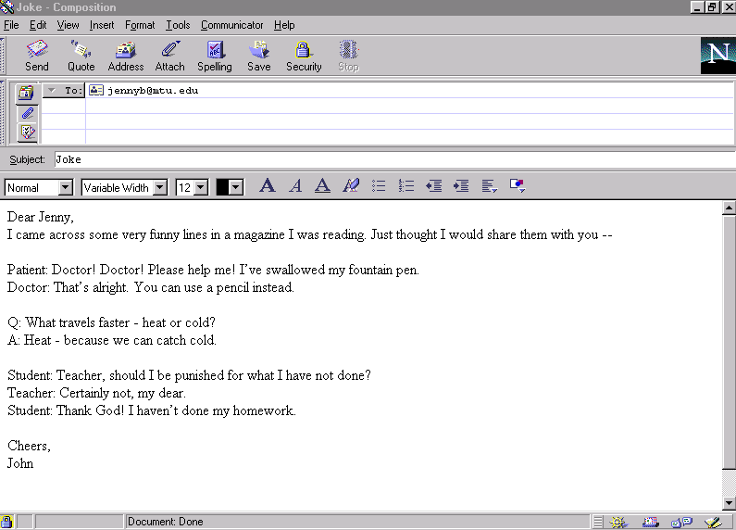
Sample Mail Composition
Receiver’s Address
Message

Slide 36
Email Addresses (contd...)
jennyb@mtu.edu
Made up of 02 parts :
jennyb
mtu.edu

Slide 37
Advantages of email
Speed
Multimedia
Cost

Slide 38
Disadvantages of email
Can be sent only to people with an email-id
Cannot send anything physical

Slide 39
Connecting the pieces
Basically Internet does only two things:
Allows computer to computer connection
Allows files to be transferred

Slide 40

TCP/IP
IP picks up packets, and ensures that they reach the destination.
TCP tracks the
packets
Internet
TCP assembles packets after checking for errors, missed packets etc.
TCP breaks up data into packets

Slide 41
TCP/IP (contd...)
HTTP
FTP
SMTP
POP3
IMAP
...
are based on TCP/IP

Slide 42
Internet Addresses
Format of an URL:
www.nameofsite.typeofsite.countrycode
Type of site Explanation
edu educational facility
com commercial organization
gov non-military government body
mil military concern
org other organization
net network resource

Slide 43
Internet Addresses (contd...)
Country code Country name
au Australia
in India
uk England
vn Vietnam
fr France
...

Slide 44
How do we get connected to a web page
Enter the address
www.aptech-worldwide.com/train.html

Slide 45
How do we get connected to a web page (contd..)
The browser then connects our computer to that of the ISP. Which is a bigger and more powerful computer.
This computer then contacts a computer that contains the locations of all the computers whose names end in the ‘com’ code.
The exact location of the computer called ‘aptech-worldwide’ is then obtained from there.

Slide 46
How do we get connected to a web page (contd..)
Once this process has been completed successfully, the server computer at the ISP, connects to the computer called ‘aptech-worldwide’,
This computer is then requested for a HTTP document.
If the server is free then it sends the page as requested, otherwise it sends a busy signal.
If such a signal is received, we should try again after some time.

Slide 47
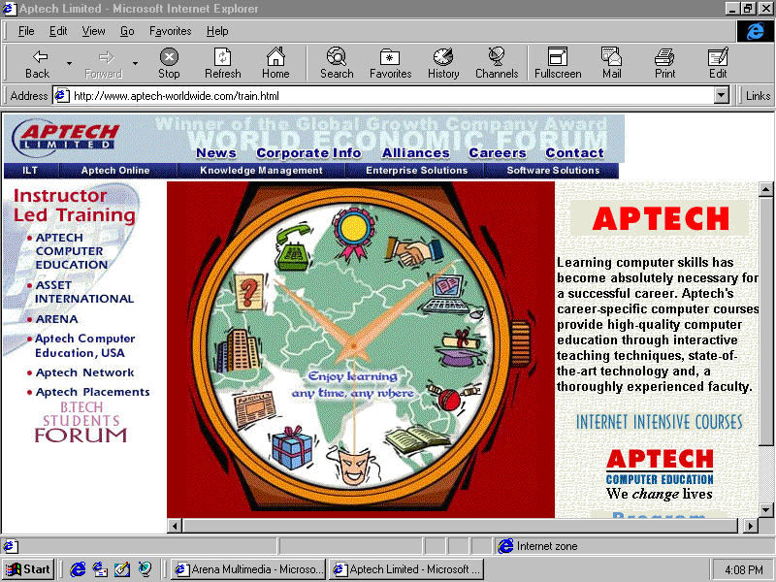
How do we get connected to a web page (contd..)

Slide 48
Requirements for an Internet Connection
Computer with Browser Software
Modem

Slide 49
Requirements for an Internet Connection
( Contd…)
Modem
  A modem translates computer signals into audible tones for transmission over a telephone line.
  A modem also interprets these audible tones and translates them back into computer signals

Slide 50
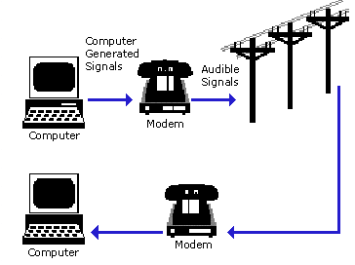
Requirements for an Internet Connection
( Contd…)

